Slide 1
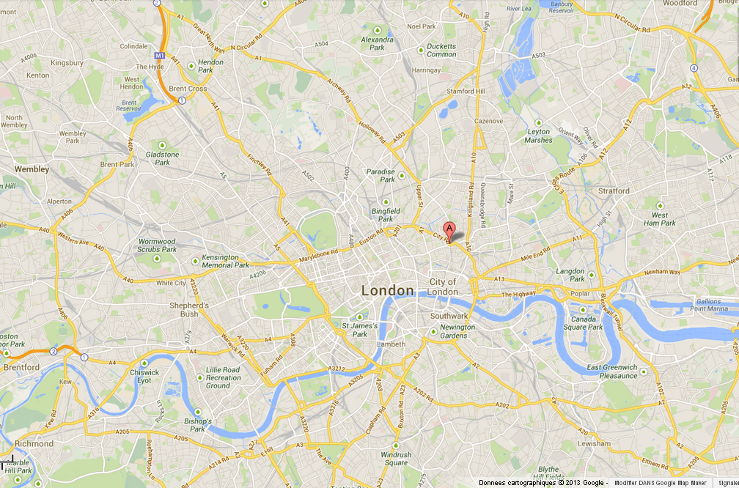
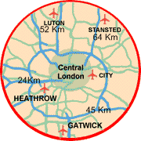
OUTER
LONDON
M 25
GREATER
LONDON
INNER
LONDON
J.O.
Techcity
CENTRAL
LONDON
City
Buckingham
Westminster
Tamise
A406

